Slide 1
NYC Taxi Data & Hospital Trend
Haipeng Pan

Slide 2
Outline
Introduction
Data Cleaning & Feature Engineering
Data Visualization & Exploratory Data Analysis
External Data
Goal Metric Extraction
RNN Model & Prediction
Conclusion

Slide 3
Introduction
How are hospitals in NYC utilized?
This project is to dig through the data of NYC Taxi rides for findings on medical trends in NYC. We will focus on rides that relate to a hospital by its coordinates or area of operation. The project consists of two parts:
1. EDA Analysis and Construction of Goal Metrics
2. RNN prediction of future trend with LSTM
The data also has two parts with different data sources:
1. 2009 to 2015, 'New York City Taxi Fare Prediction', Kaggle
2. 2017 to 2019, Taxi & Limousine Commission Trip Record Data
We will be combining the data with data from other sources in generating desired features.

Slide 4
Data Cleaning & Feature Engineering
What do we want to know from our data? What range of data should we consider?
Dataset 1, 2009 - 2015
Dataset 2, 2017 - 2019
Distance
Latitudes
0 100 (miles)
40.5° 40.9°
Duration
0 79200 (s)
Longitudes
-74.3° -73.7°
0 1000 (dollars)
Fare Amount
# Passengers
Year
0 10
2017 2019
Avg. Speed
0 100 (mph)
Both datasets consist of extreme outliers and invalid inputs

Slide 5
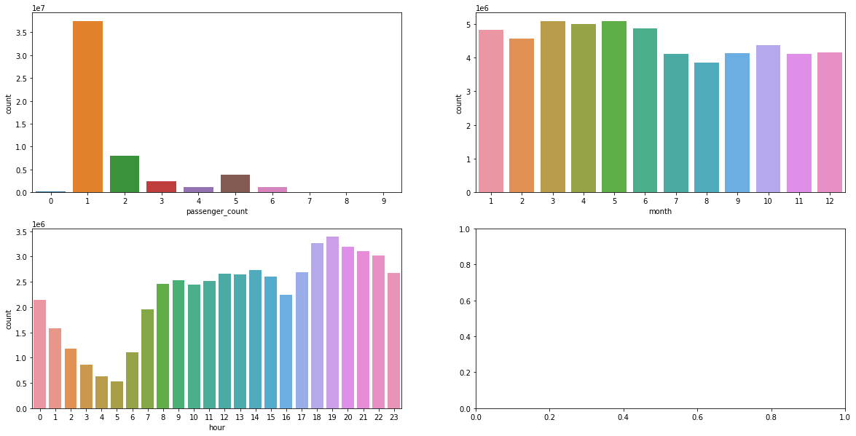
Data Visualization & Exploratory Data Analysis
How does the data look like in 2009 - 2015?
Most rides have 1 passenger
There are More rides in the Spring and less in the Summer
Peak hour is at 7 pm

Slide 6
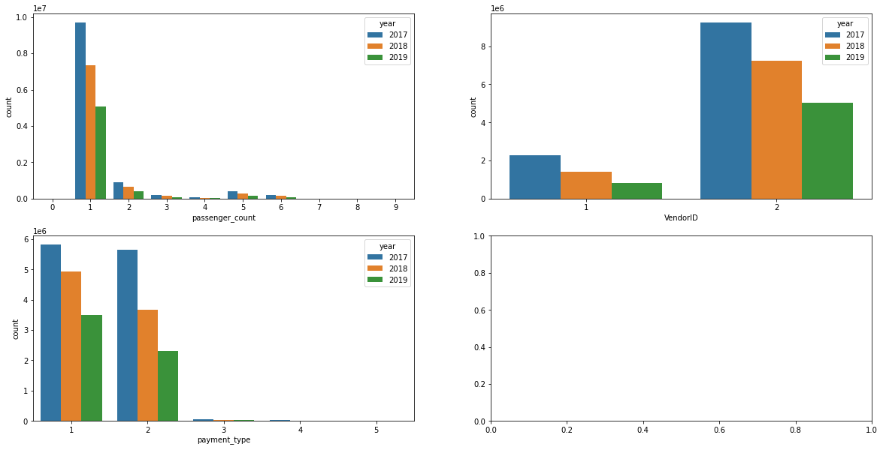
Data Visualization & Exploratory Data Analysis
How does the data look like in 2017 - 2019?
1 = Credit Card
2 = Cash
1= Creative Mobile Technologies, LLC
2= VeriFone Inc.
The portion of cash payment is decreasing
VeriFone has taken most of the market shares

Slide 7
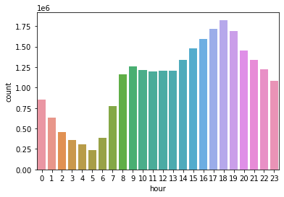
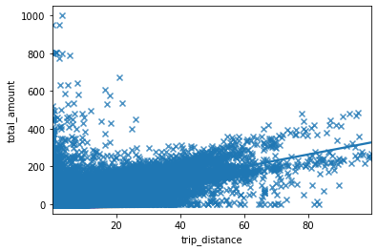
Data Visualization & Exploratory Data Analysis
How does the data look like in 2017 - 2019?
Peak hour is now at 6 pm
Some passengers paid high prices for very short trips

Slide 8
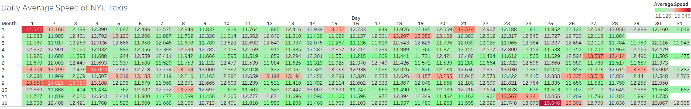
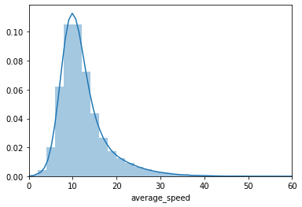
Data Visualization & Exploratory Data Analysis
How does the data look like in 2017 - 2019?
Average Speed
derived by Distance/Duration
right-skewing bell-shaped distribution
highest average speeds on Holidays

Slide 9
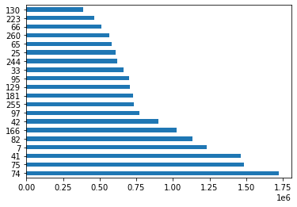
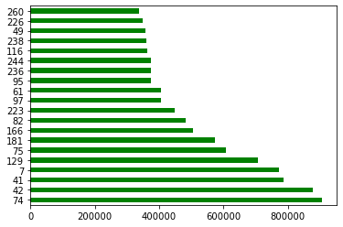
Data Visualization & Exploratory Data Analysis
How does the data look like in 2017 - 2019?
Places with Most Taxi Businesses:
74: East Harlem North, Manhattan
41: Central Harlem, Manhattan
75: East Harlem South, Manhattan
42: Central Harlem North, Manhattan
7: Astoria, Queens
166: Morningside Heights, Manhattan
129: Jackson Heights, Queens
181: Park Slope, Brooklyn
Pick-Up
Drop-Off

Slide 10
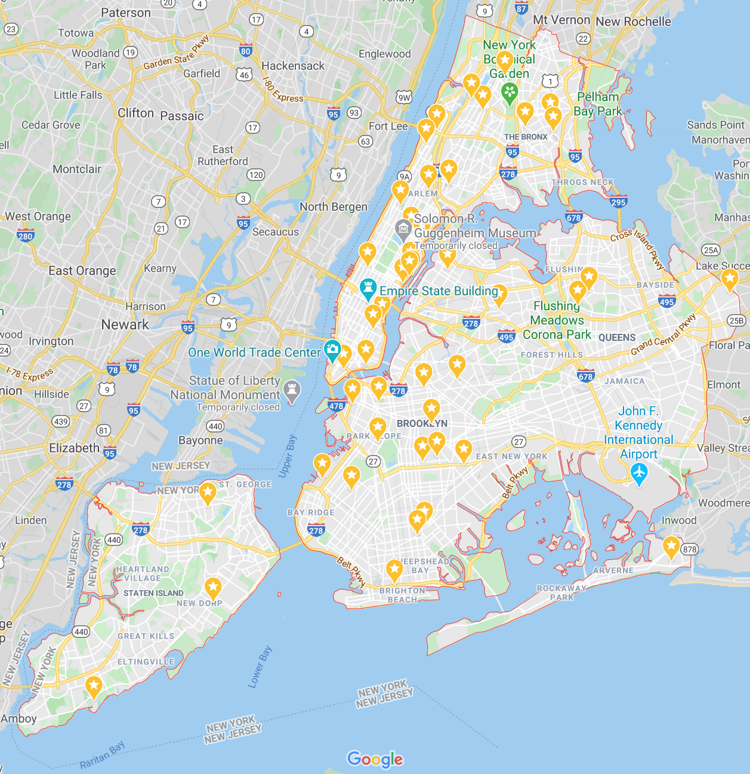
External Data
How do we define ‘going to hospitals’?
Dataset | 2009 - 2015 | 2017 - 2019
Location Information | Coordinates | Area Codes
Going to Hospital if Trip Ends … | In the surrounding streets | In the same area*
*Some popular areas excluded for better accuracy

Slide 11
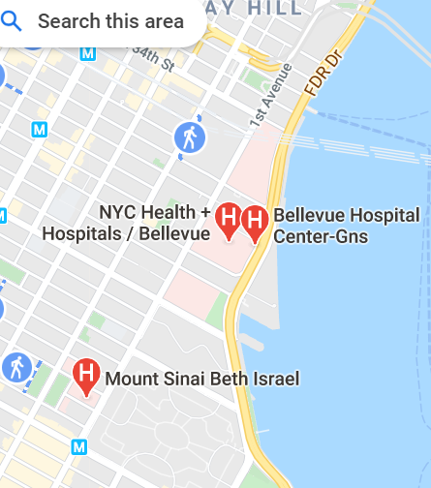
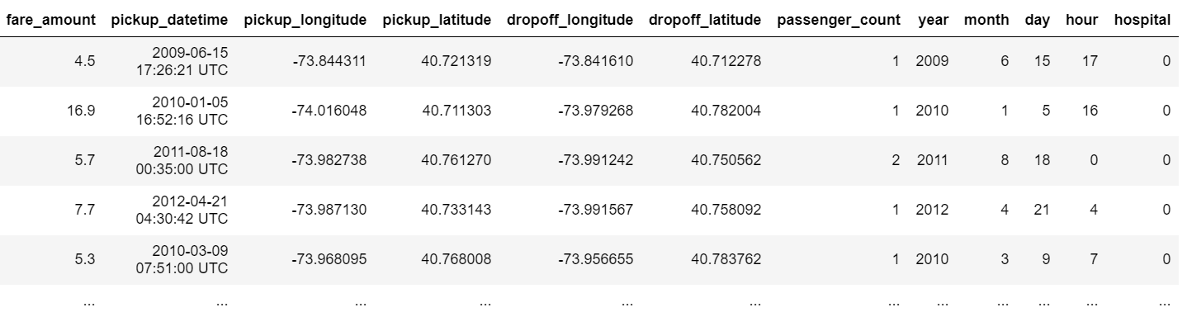
Goal Metric Extraction
After classifying the rides by the drop-off location…
We get the metric feature ‘hospital’:
1 = going to hospital
0 = not going to hospital

Slide 12
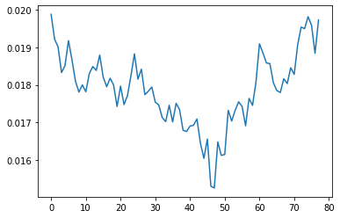
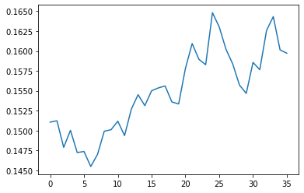
RNN Model & Prediction
Are New Yorkers going to hospitals by taxis more often or less?
Dataset 1, 2009 - 2015
Dataset 2, 2017 - 2019
Jan. 2019
Dec. 2012
Note:
1. X-axis is ‘Months’ and Y-axis is ‘portion of rides going to hospitals’
2. Since we use larger areas in dataset 2, the results are much higher and not as accurate, but we can still observe the trend

Slide 13
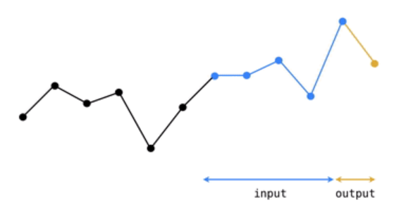
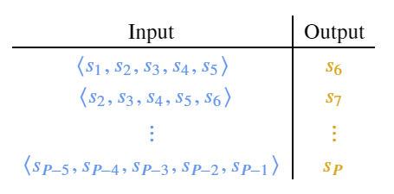
RNN Model & Prediction
Are New Yorkers going to hospitals by taxis more often or less?
Long-Short Term Memory (LSTM)
LSTM is an RNN architecture that predicts the next point of data based on previous trend and works with both single data points and sequence of data.

Slide 14
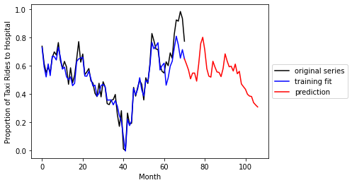
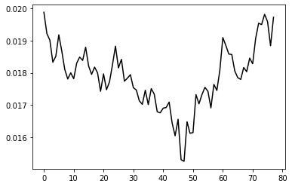
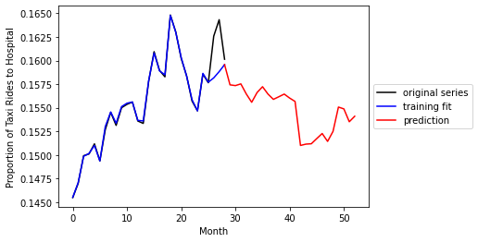
RNN Model & Prediction
Are New Yorkers going to hospitals by taxis more often or less?
Dataset 1, 2009 - 2015
Dataset 2, 2017 - 2019
Fewer ‘hospital taxis’ in 2012 – 2013
More ‘hospital taxis’ in 2015
The model predicts a decreasing trend
after the peak, possibly better than it
was in 2009
Number of ‘hospital taxis’ increasing after 2017
The model predicts a decreasing trend after the peak, but will stay higher than it was in 2017

Slide 15
Conclusion
What have we known?
Exploited trip-level taxi data from two distinct sources to discover patterns of going to hospitals by taxi, and further predicted future trend for both situations using the LSTM model.
The trend shows a 25% decrease in NYC passengers going to hospital by taxis in 2012 than in 2009, while the number increased throughout 2017 to 2019.
The model predicts fewer ‘hospital taxis’ for both situations in their futures.
More improvement can be made if a better technique of detection for ‘going to hospital’ was presented, with a more rigorous method of classifying trips going for medical purposes.

Slide 16
Thank You Very Much for Your Time

